Slide 1
CSD1400 Software Engineering Project 1
Class Overview & Introduction
Instructor
Cheng Ding Xiang
cheng.dingxiang@digipen.edu
Gerald Wong
g.wong@digipen.edu
Office Hours
By Appointment
Instructor Intro
Class Introduction
Class Overview

Slide 2

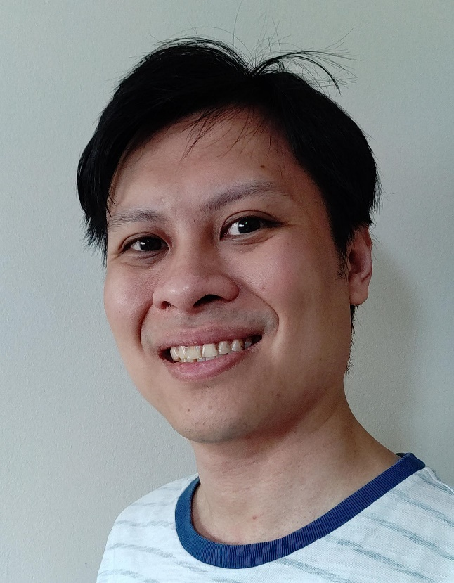
Instructors
Cheng Ding Xiang
Lecturer
RTIS Alumni
Gerald Wong
Lecturer
IMGD Alumni

Slide 3
Class Introduction
The class formerly known as GAM100

Slide 4
The Project Class
Where students work together to create a product, from start to finish.
There is a project class for every degree, for every year of study
Our product will be a GAME.

Slide 5
Overall Objective
Develop an interactive software
Learn and practise the processes of software development and production

Slide 6
You Start with This …

Slide 7
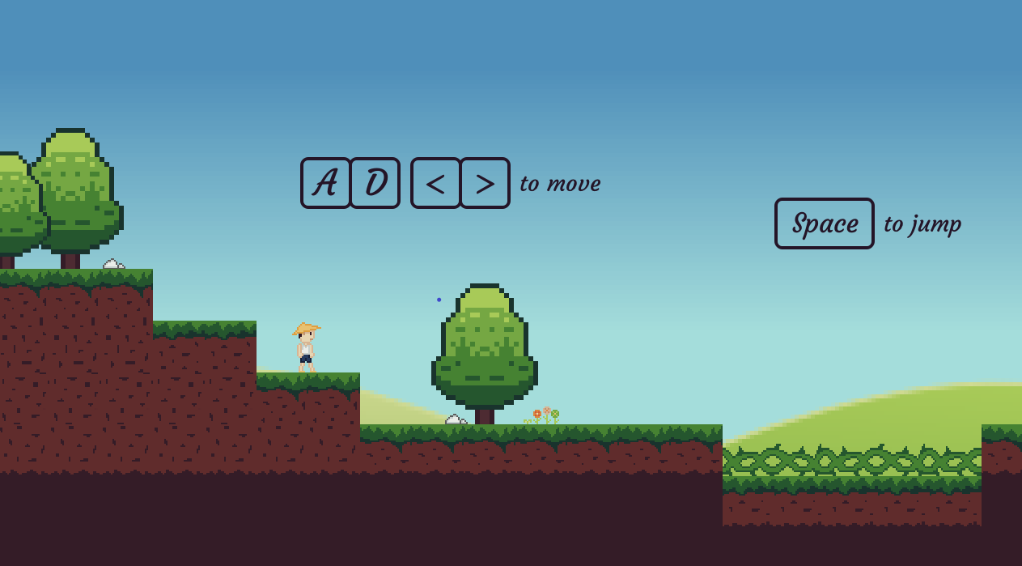
.. Finish with this (just an example)

Slide 8
Learning by Doing
Apply what you learnt from other classes:
Programming
Mathematics
Communication
Design
Mythology
Psychology
Etc.
Nothing you learn/experience goes to waste :D

Slide 9
Learning by Doing
Apply what you learnt from your life:
Hobbies
Reflections
Experiences
Dreams
Perspectives
etc
Nothing you learn/experience goes to waste :D

Slide 10
Software Development
What you will/should be doing (a lot of):
Coding
Planning
Communicating
Testing
Adapting
Problem solving

Slide 11
You graduate with
Strong foundation in technical skills
Production experience
Network (peers and industry)
And …….

Slide 12
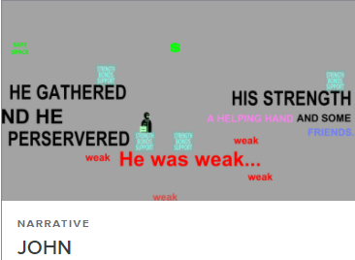
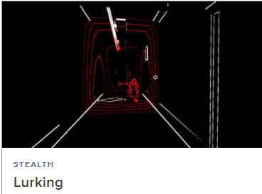

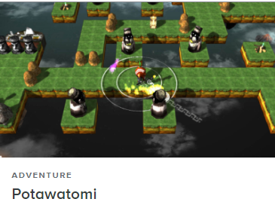
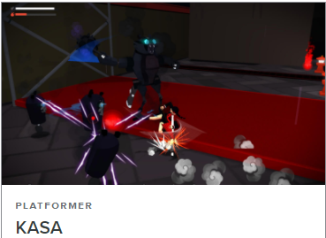
You graduate with
..Portfolio

Slide 13

Housekeeping

Slide 14
Housekeeping Stuff
Class Structure
Instruction : Lectures with tutorials
Evaluation : Presentations and submissions
Lab : Working on software projects

Slide 15
Housekeeping Stuff
Learning Platforms and Resources
Microsoft Teams : For communication. E.g. Announcement, consultations, playtesting etc.
Moodle : For class resources, submissions, online attendance and grades
Lectures and presentations will be streamed and recorded
Make sure you have access

Slide 16
Microsoft Teams
Shared team page:
Channels
Announcements
General
Lectures
Labs
Looking For Group

Slide 17
Moodle
Do you have access to Moodle?
Syllabus has been posted there. (let’s check it out)
Slides will be updated there.
Used for grading.
Submit stuff on time: I won’t chase you, I’ll just deduct marks.

Slide 18
Housekeeping Stuff
Safety
Wear masks at all times
No Eating in class

Slide 19
Safety
Not adhering to safety measures will incur penalties
I will bring down the final grade of repeat offenders

Slide 20
Teaching Assistants

Slide 21
Teaching Assistants
Your seniors with knowledge and experience
Here to help in class
Hired to support the class during class hours
For help beyond class time, look towards the Academic Support Center and your instructors

Slide 22
Teaching Assistants
Be professional when communicating with them
They are students too, with their own classes to handle
Respect their time and invested commitment
Also they graduate before you do, so…….
Please come back to TA after you have completed the class :D

Slide 23
Moving forward
Week (s) | Tasks
1 | Ensure you have access to all resources, find a team
2 | Settle with team and set up team foundations
3 - 6 | Programming Projects (Solo)
6 | Mid Term Assessment (Solo project submissions)
8 | Pitch your project idea (Team)
8 -13 | Finish your project ( Team, Testing on week 12)
14 | Final Presentation (Team)

Slide 24
Grading

Slide 25
Grade Scale
Generally base letter grades will be given : A, B, C, F
Modifiers will then move that grade up or down this scale
Gap between D and F is a lot wider than represented
Grade | Description
A+ | Excellent
A
A-
B+ | Very Good
B
B-
C+ | Good
C
D+ | Adequate
D
F | Fail

Slide 26
Grade Scale
Modifier examples :
Submission penalties
Bonuses for special achievements
Grade | Description
A+ | Excellent
A
A-
B+ | Very Good
B
B-
C+ | Good
C
D+ | Adequate
D
F | Fail

Slide 27
Grading Policy
This is a PASS or FAIL class, and will NOT affect your CGPA
Letter grades will still be given based on the SIT grading policy to reflect your achievement in all forms of evaluation
A cumulative letter grade will be computed to determine your final letter grade to determine if you pass or fail

Slide 28
Grading Policy
Note that in other classes, you may pass the class with a low letter grade, but it would severely hurt your CGPA
Strive for excellence and attain all learning outcomes
Do not cheat. I may fail you for that assignment or worse.

Slide 29
Programming Projects(Weeks 3 – 6)
Solo Effort
Heavily guided, clear weekly targets
Establish foundations for all students

Slide 30
Mid Term Assessment (Week 6)
Students will be required to submit two of the programming projects:
Car Selection Game (given in week 4)
Game of Life (given in week 5)
Students will need to pass this assessment to pass the class.

Slide 31
Team Project (Weeks 8 – 13)
Unguided, weekly targets set by the team
Everyone must contribute meaningfully to the project
Code contributions from everyone
Penalties for lack of contribution, failure of this class if no contribution

Slide 32
Why we are doing this

Slide 33

EMPLOYMENT
92% employed within 6 months of graduation
42% pursued their career in a non-game industry after graduation
Degree Program | Median Gross Monthly Salary
 | 2018
Bachelor of Science in Computer Science in Real-Time Interactive Simulation | $4,016
Bachelor of Science in Computer Science & Game Design | $3,600
Bachelor of Arts in Game Design | $3,300
Bachelor of Fine Arts in Digital Art & Animation | $2,800
Source: MOE Joint Graduate Employment Survey (2018) Career and Alumni Services, DigiPen (Singapore)
*There were no BEng in Systems Engineering (Electromechanical Systems) alumni surveyed in MOE GES 2018

Slide 34












































EMPLOYMENT
Video Games, VFX & Animation
Software & Digital Media
Other Industries
* Across all 5 of our degree programs

Slide 35
Know why you are here
What do you want to achieve here ?
What kind of future are you working towards?

Slide 36
Know why you are here
Midterm milestone
Week 7 is a milestone where you decide whether to continue or drop the course
Use the midterm grade to reflect upon your efforts and what you really want
Final grades will be released on IN4SIT. This is the grade counted towards your graduation.

Slide 37
A Peak into the future
Watch the videos

Slide 38
Conclusion
Work towards your long term future
Learn as much as you can
Dare to try new things
Do not waste time trying to “game” the system
Be proactive, not reactive
Do your due diligence
Ask for help

Slide 39
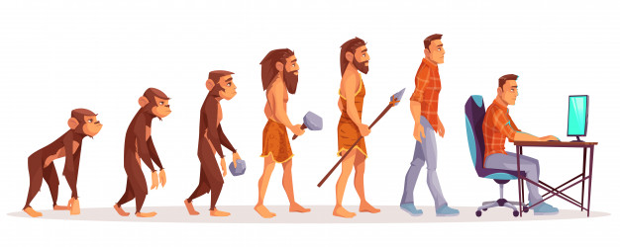
Also..
Look after your health

